Slide 1
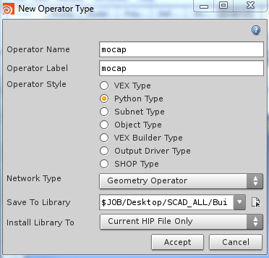
Step 1: File->NewOperator Type
Change the operator name/label
Python Type
Geometry Operator
Save locally (to your $HIP directory

Slide 2
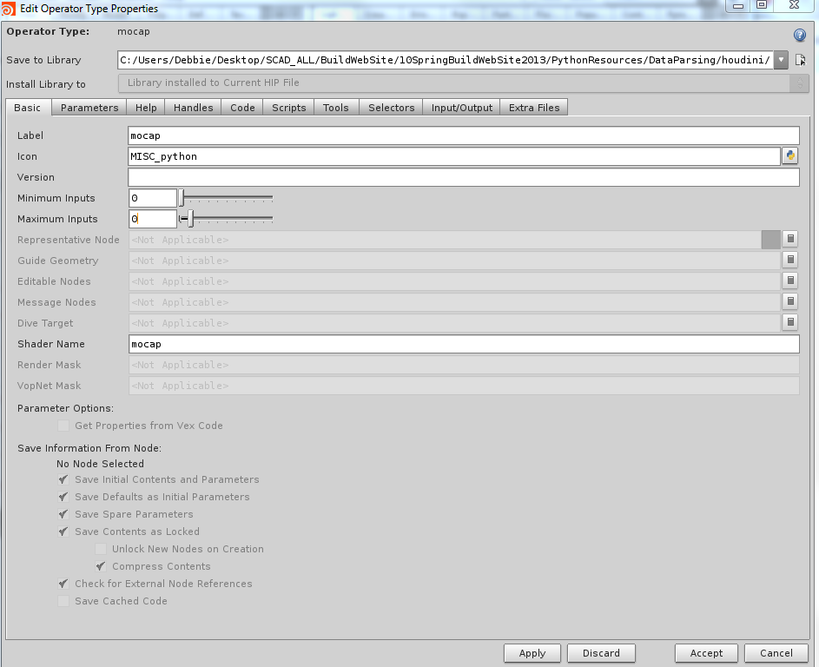
Set to zero
Step 2: Set Minimum and Maximum Inputs to zero

Slide 3
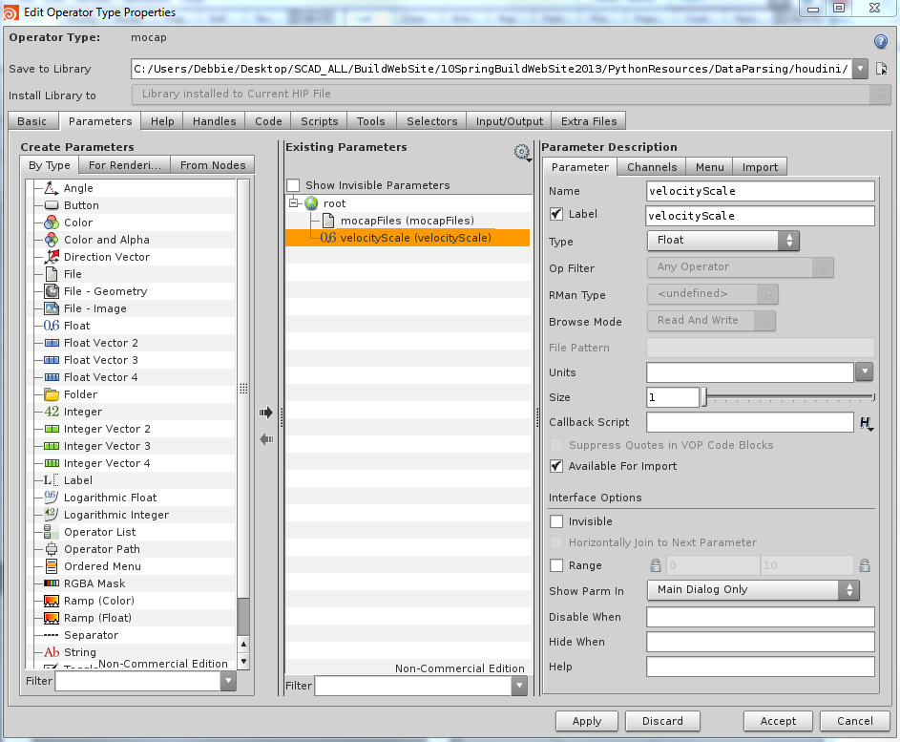
Drag from left panel to middle for parameter of that type - rename

Slide 4
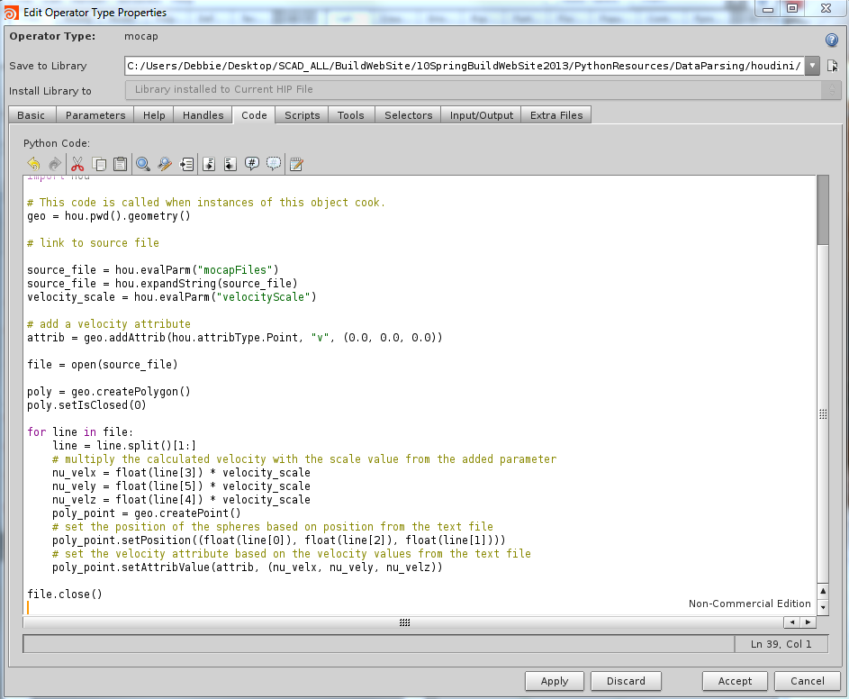
Put code in Code tab

Slide 5
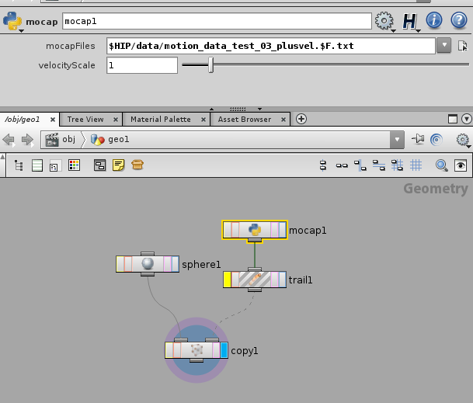
Set your parameters to point to the files

